Slide 1
Estimation and Confidence Intervals
9
Notes:
‹#›

Slide 2
GOALS
Define a point estimate.
Define level of confidence.
Construct a confidence interval for the population mean when the population standard deviation is known.
Construct a confidence interval for a population mean when the population standard deviation is unknown.
Construct a confidence interval for a population proportion.
Determine the sample size for attribute and variable sampling.
Notes:
‹#›

Slide 3
Sampling and Estimates
Why Use Sampling?
To contact the entire population is too time consuming.
The cost of studying all the items in the population is often too expensive.
The sample results are usually adequate.
Certain tests are destructive.
Checking all the items is physically impossible.
Point Estimate versus Confidence Interval Estimate
A point estimate is a single value (point) derived from a sample and used to estimate a population value.
A confidence interval estimate is a range of values constructed from sample data so that the population parameter is likely to occur within that range at a specified probability. The specified probability is called the level of confidence.
What are the factors that determine the width of a confidence interval?
1.The sample size, n.
2.The variability in the population, usually σ estimated by s.
3.The desired level of confidence.
Notes:
‹#›

Slide 4
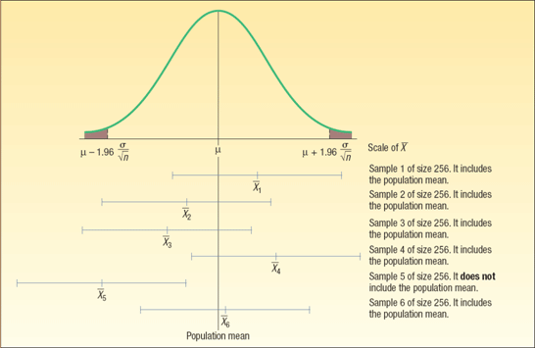
Interval Estimates - Interpretation
For a 95% confidence interval about 95% of the similarly constructed intervals will contain the parameter being estimated. Also 95% of the sample means for a specified sample size will lie within 1.96 standard deviations of the hypothesized population
Notes:
‹#›

Slide 5
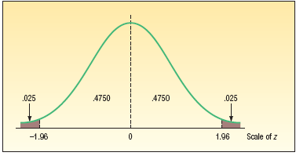
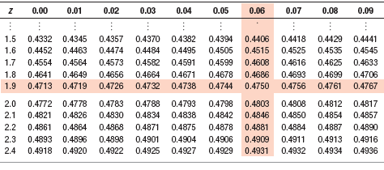
How to Obtain z value for a Given Confidence Level
The 95 percent confidence refers to the middle 95 percent of the observations. Therefore, the remaining 5 percent are equally divided between the two tails.
Following is a portion of Appendix B.1.
Notes:
‹#›

Slide 6
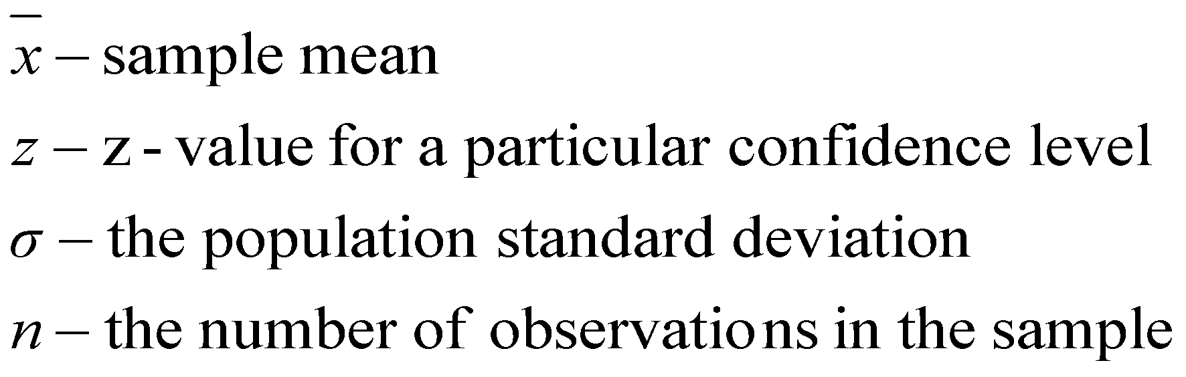
Point Estimates and Confidence Intervals for a Mean – σ Known
EXAMPLE
The American Management Association wishes to have information on the mean income of middle managers in the retail industry. A random sample of 256 managers reveals a sample mean of $45,420. The standard deviation of this population is $2,050. The association would like answers to the following questions:
1. What is the population mean?
In this case, we do not know. We do know the sample mean is $45,420. Hence, our best estimate of the unknown population value is the corresponding sample statistic.
What is a reasonable range of values for the population mean? (Use 95% confidence level)
The confidence limit are $45,169 and $45,671
The ±$251 is referred to as the margin of error
What do these results mean?
If we select many samples of 256 managers, and for each sample we compute the mean and then construct a 95 percent confidence interval, we could expect about 95 percent of these confidence intervals to contain the population mean.
The width of the interval is determined by the level of confidence and the size of the standard error of the mean.
The standard error is affected by two values:
Standard deviation
Number of observations in the sample
Notes:
‹#›

Slide 7
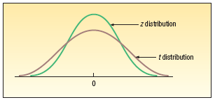
Population Standard Deviation (σ) Unknown – The t-Distribution
In most sampling situations the population standard deviation (σ) is not known. Below are some examples where it is unlikely the population standard deviations would be known.
The Dean of the Business College wants to estimate the mean number of hours full-time students work at paying jobs each week. He selects a sample of 30 students, contacts each student and asks them how many hours they worked last week.
The Dean of Students wants to estimate the distance the typical commuter student travels to class. She selects a sample of 40 commuter students, contacts each, and determines the one-way distance from each student’s home to the center of campus.
CHARACTERISTICS OF THE t-Distribution
1. It is, like the z distribution, a continuous distribution.
2. It is, like the z distribution, bell-shaped and symmetrical.
3. There is not one t distribution, but rather a family of t distributions. All t distributions have a mean of 0, but their standard deviations differ according to the sample size, n.
4. The t distribution is more spread out and flatter at the center than the standard normal distribution As the sample size increases, however, the t distribution approaches the standard normal distribution
Notes:
‹#›

Slide 8
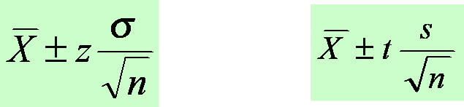
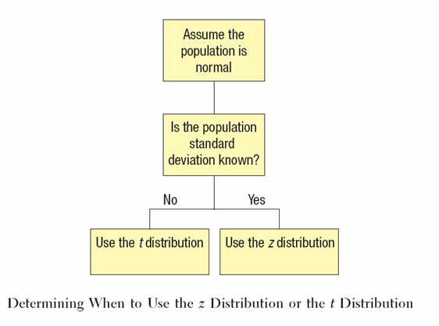
Confidence Interval Estimates for the Mean
Use Z-distribution
If the population standard deviation is known or the sample is greater than 30.
Use t-distribution
If the population standard deviation is unknown and the sample is less than 30.
Notes:
‹#›

Slide 9
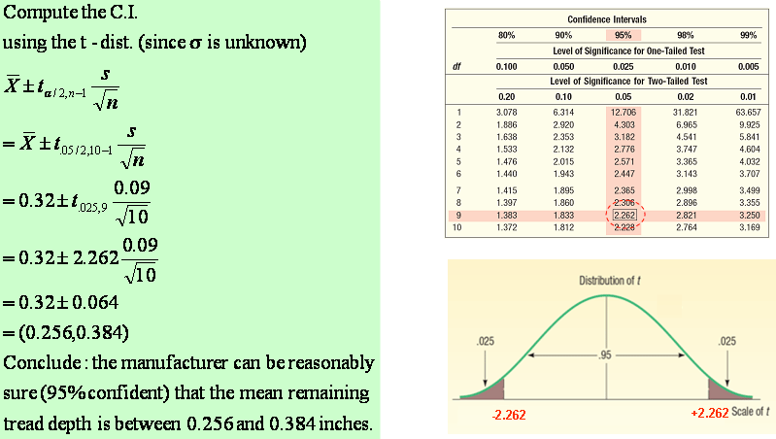
Confidence Interval for the Mean – Example using the t-distribution
EXAMPLE
A tire manufacturer wishes to investigate the tread life of its tires. A sample of 10 tires driven 50,000 miles revealed a sample mean of 0.32 inch of tread remaining with a standard deviation of 0.09 inch.
Construct a 95 percent confidence interval for the population mean.
Would it be reasonable for the manufacturer to conclude that after 50,000 miles the population mean amount of tread remaining is 0.30 inches?
Notes:
‹#›

Slide 10
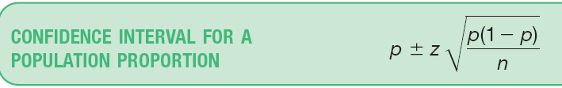
A Confidence Interval for a Proportion (π)
The examples below illustrate the nominal scale of measurement.
The career services director at Southern Technical Institute reports that 80 percent of its graduates enter the job market in a position related to their field of study.
A company representative claims that 45 percent of Burger King sales are made at the drive-through window.
A survey of homes in the Chicago area indicated that 85 percent of the new construction had central air conditioning.
A recent survey of married men between the ages of 35 and 50 found that 63 percent felt that both partners should earn a living.
Using the Normal Distribution to Approximate the Binomial Distribution
To develop a confidence interval for a proportion, we need to meet the following assumptions.
1. The binomial conditions, discussed in Chapter 6, have been met. Briefly, these conditions are:
a. The sample data is the result of counts.
b. There are only two possible outcomes.
c. The probability of a success remains the same from one trial to the next.
d. The trials are independent. This means the outcome on one trial does not affect the outcome on another.
2. The values n π and n(1-π) should both be greater than or equal to 5. This condition allows us to invoke the central limit theorem and employ the standard normal distribution, that is, z, to complete a confidence interval.
Notes:
‹#›

Slide 11
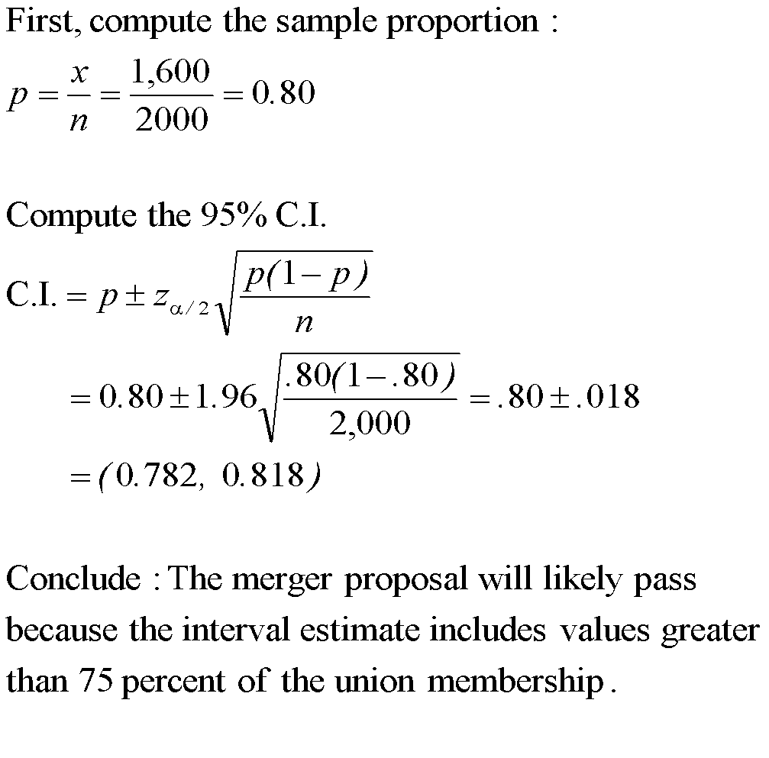
Confidence Interval for a Population Proportion- Example
EXAMPLE
The union representing the Bottle Blowers of America (BBA) is considering a proposal to merge with the Teamsters Union. According to BBA union bylaws, at least three-fourths of the union membership must approve any merger. A random sample of 2,000 current BBA members reveals 1,600 plan to vote for the merger proposal. What is the estimate of the population proportion?
`
Develop a 95 percent confidence interval for the population proportion. Basing your decision on this sample information, can you conclude that the necessary proportion of BBA members favor the merger? Why?
Notes:
‹#›

Slide 12
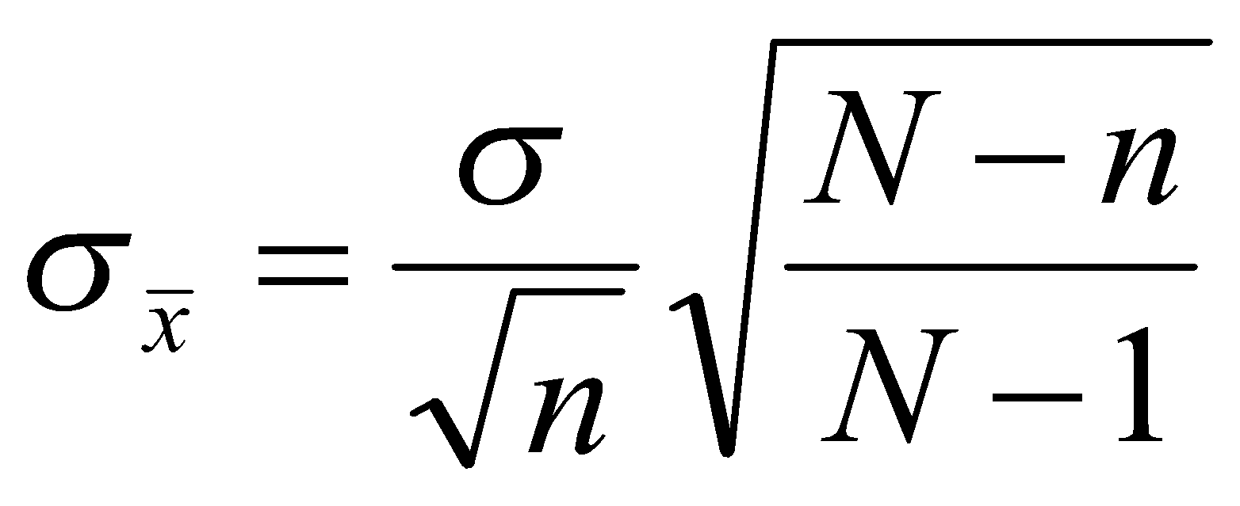
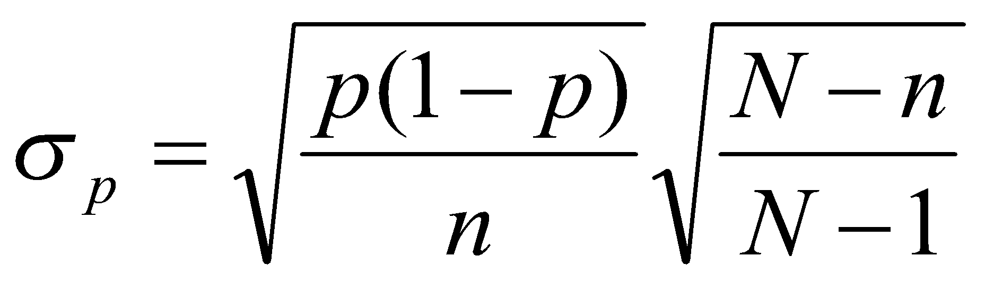
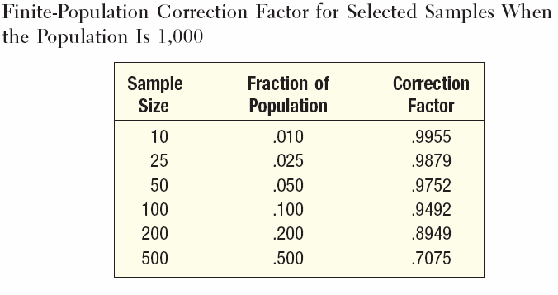
Finite-Population Correction Factor
A population that has a fixed upper bound is said to be finite.
For a finite population, where the total number of objects is N and the size of the sample is n, the following adjustment is made to the standard errors of the sample means and the proportion:
However, if n/N < .05, the finite-population correction factor may be ignored. Why? See what happens to the value of the correction factor in the table below when the fraction n/N becomes smaller
The FPC approaches 1 when n/N becomes smaller!
Standard Error of the Mean
Standard Error of the Proportion
Notes:
‹#›

Slide 13
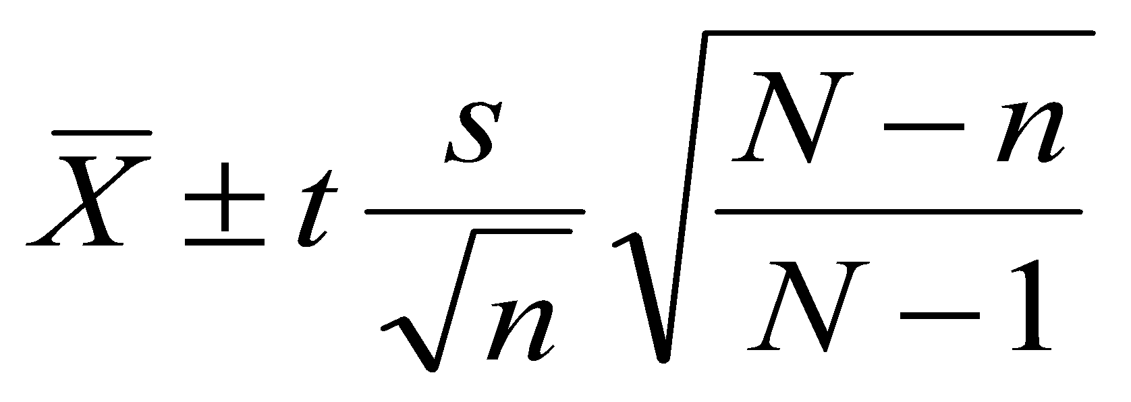
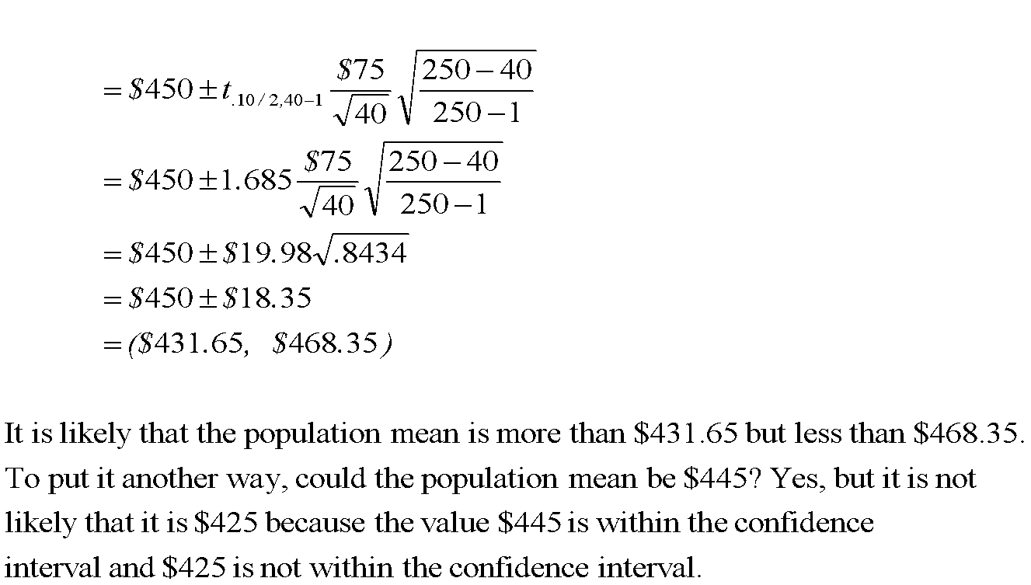
CI for Mean with FPC - Example
EXAMPLE
There are 250 families in Scandia, Pennsylvania. A random sample of 40 of these families revealed the mean annual church contribution was $450 and the standard deviation of this was $75.
Could the population mean be $445 or $425?
What is the population mean? What is the best estimate of the population mean?
Given in Problem:
N – 250
n – 40
s - $75
Since n/N = 40/250 = 0.16, the finite population correction factor must be used.
The population standard deviation is not known therefore use the t-distribution (may use the z-dist since n>30)
Notes:
‹#›

Slide 14
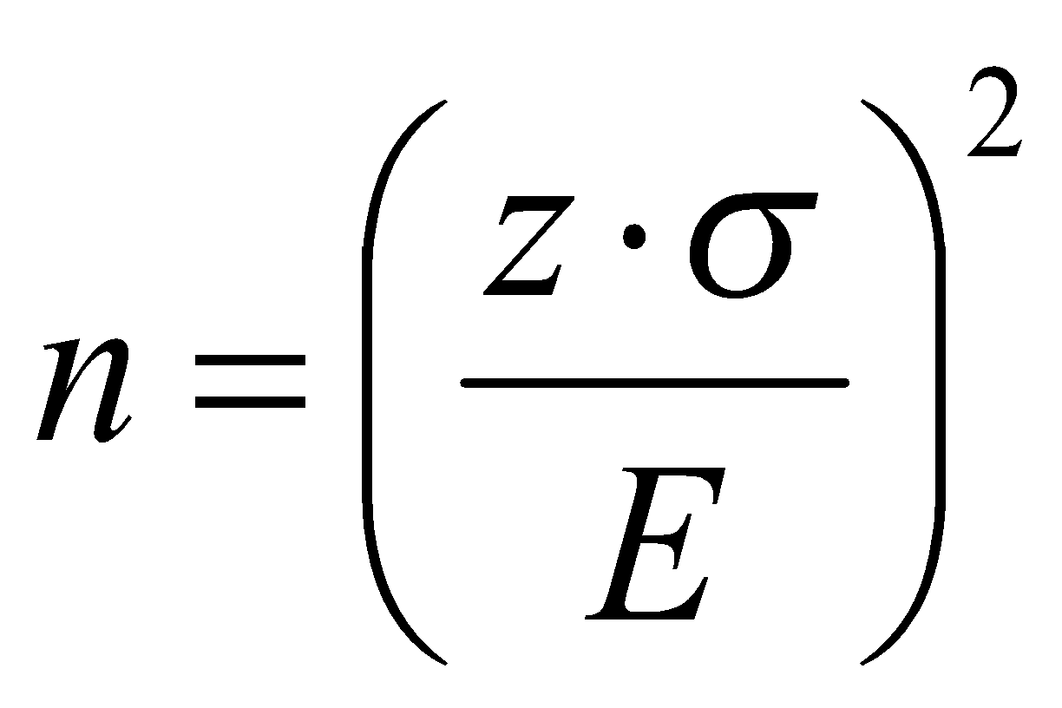
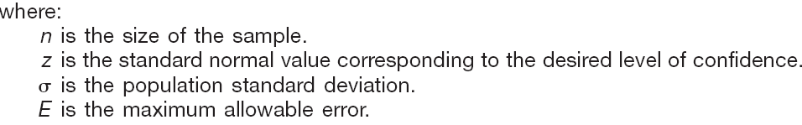
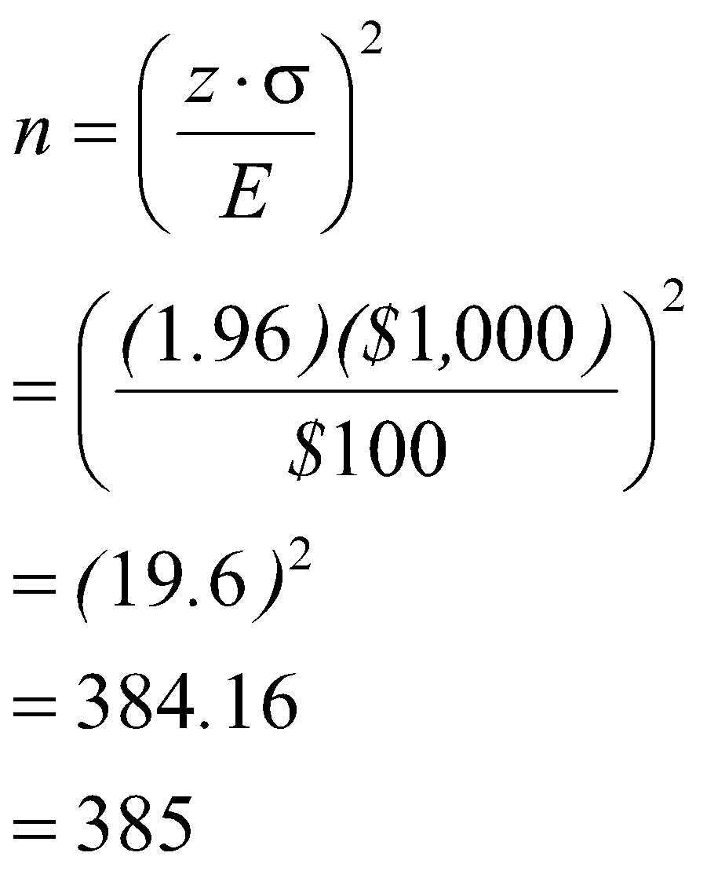
Selecting an Appropriate Sample Size
EXAMPLE
A student in public administration wants to determine the mean amount members of city councils in large cities earn per month as remuneration for being a council member. The error in estimating the mean is to be less than $100 with a 95 percent level of confidence. The student found a report by the Department of Labor that estimated the standard deviation to be $1,000. What is the required sample size?
Given in the problem:
E, the maximum allowable error, is $100
The value of z for a 95 percent level of confidence is 1.96,
The estimate of the standard deviation is $1,000.
There are 3 factors that determine the size of a sample, none of which has any direct relationship to the size of the population.
The level of confidence desired.
The margin of error the researcher will tolerate.
The variation in the population being Studied.
Notes:
‹#›

Slide 15
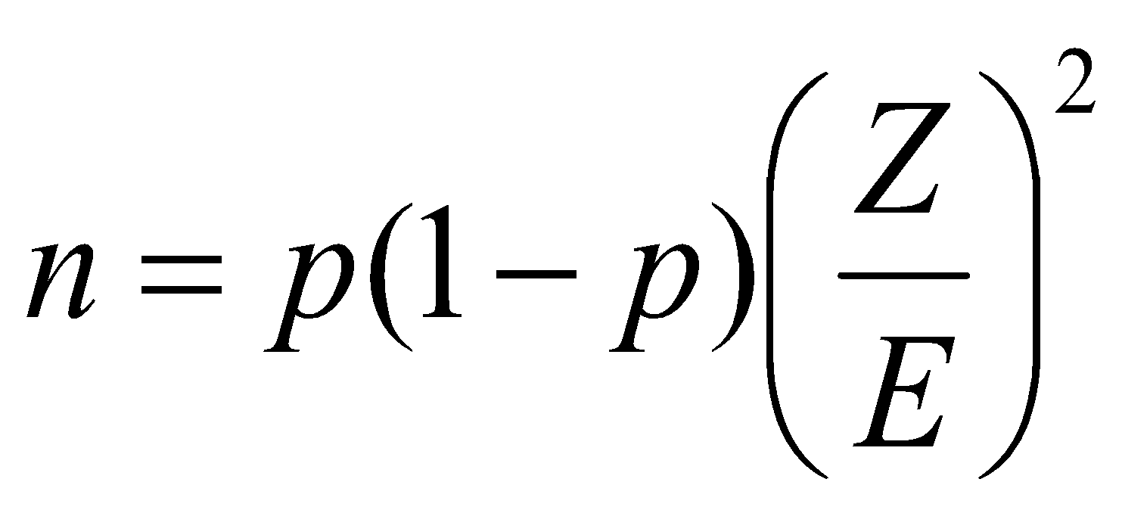
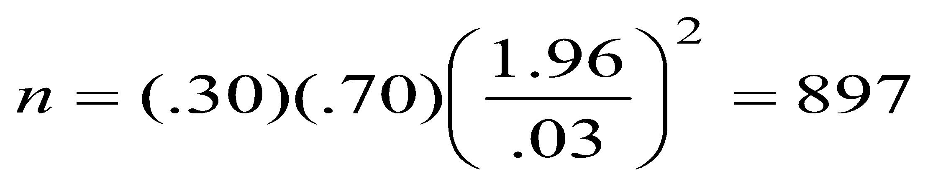
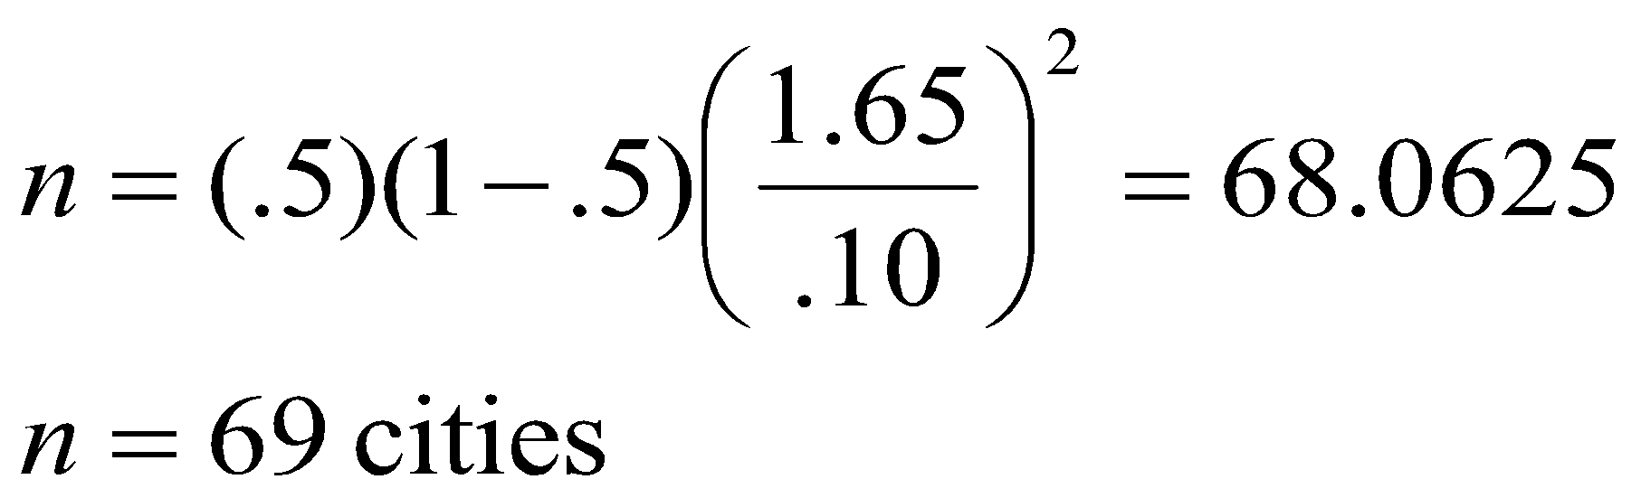
Sample Size for Estimating a Population Proportion
EXAMPLE 1
The American Kennel Club wanted to estimate the proportion of children that have a dog as a pet. If the club wanted the estimate to be within 3% of the population proportion, how many children would they need to contact? Assume a 95% level of confidence and that the club estimated that 30% of the children have a dog as a pet.
EXAMPLE 2
A study needs to estimate the proportion of cities that have private refuse collectors. The investigator wants the margin of error to be within .10 of the population proportion, the desired level of confidence is 90 percent, and no estimate is available for the population proportion. What is the required sample size?
where:
n is the size of the sample
z is the standard normal value
corresponding to the desired level of confidence E is the maximum allowable error
NOTE:
use p = 0.5 if no initial information on the probability of success is available
Notes:
‹#›

